Slide 1
TRAVELLING SALESMAN PROBLEM
-GROUP 12

Slide 2
TEAM MEMBERS
AP20110010407- V. Likhith
AP20110010409- P. Jaanakiswaroop
AP20110010410- G. Chandrashekar
AP20110010411- Y. Navaneetha

Slide 3
Table of Contents
01
05
02
03
INTRODUCTION
APPLICATIONS
EXPLANATION
06
CONCLUSION
07
ALGORITHMS
REFERNCES
04
COMPARISON

Slide 4
INTRODUCTION
Traveling salesman problem (TSP) means that a travelling salesman needs to promote products in n cities (including the city where he lives). After visiting each city (each city can be visited once), he returns to the departure city.
Main aim of TSP is to find the shortest possible route whether in form of distance or cost.
In this presentation we will learn about Travelling salesman problem with two different algorithms.

Slide 5
ExPlanation
TSP can be described as: Given a set of cities(vertex) , and the distances between each pair of the cities(edges).
We have a weighted complete graph; each edge has a number called the weight attached to it. Each path has a total weight, the sum of the weights of the edges in the path.
So the “travelling sales man problem”, TSP is to find the Hamilton circuit with the smallest total weight.
This problem can be solved in many ways. Here, are two of them:
1.Cheapest- Link Algorithm
2.Nearest Neighbour Algorithm

Slide 6
Cheapest-link algorithm
Algorithm:
Step 1: Pick any edge with cheapest weight and mark it.
Step 2: Pick the next cheapest unmarked edge unless:
(i) Picked new edge closes a smaller circuit
(ii) Picked new edge results in 3rd marked edges coming out of a single vertex
Step 3: Repeat step 2 until the Hamilton circuit is complete.

Slide 7
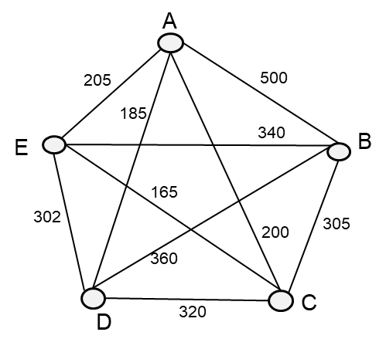
Lets us consider the following weighted graph with vertices A,B,C,D,E and edges are
AB=500, BC=305, CD=320, DE=302, EA=205, AD=185,
DB=360, BE=340, EC=165, CA=200
Since, 165 is small weight we consider that then mark it.
Next we consider 185 and mark it.
Even though next small weight is 205, we will not consider it because it results in 3rd marked edge coming from A. So ignore that edge
Now, if we consider 302 that will results in forming of smaller circuit. Ignore it.
Similarly 305,320 results in 3rd marked edges so, jump them and consider 340 and 360 edges .

Slide 8
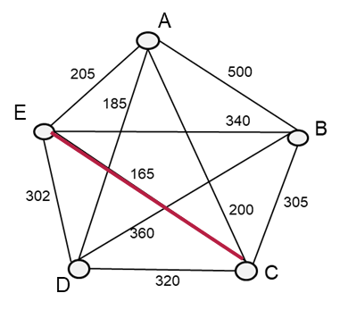
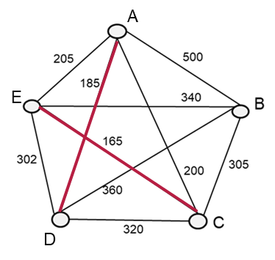
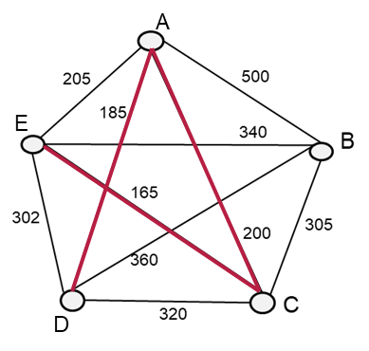
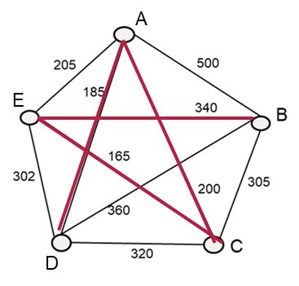
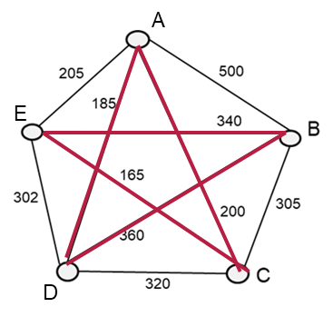
Output edges:- EC-AD-CA-BE-DB
=165+185+200+340+360
=1250
Our circuit is: A-D-B-E-C-A

Slide 9
NEAREST NEIGHBOUR ALGORITHM
Algorithm:
Step 1: Select any node as starting node.
Step 2: Look for the neighbours of the starting node that have not been visited yet. Choose the node which is next closest to that node having the minimum distance.
Step 3: Repeat this procedure until all the nodes in the tour have been visited exactly once.
Step 4: Check if all the nodes are visited atleast once. If yes, then return back to the starting node which will give the complete path.
Step 5: Finally calculate the total distance of the tour.

Slide 10
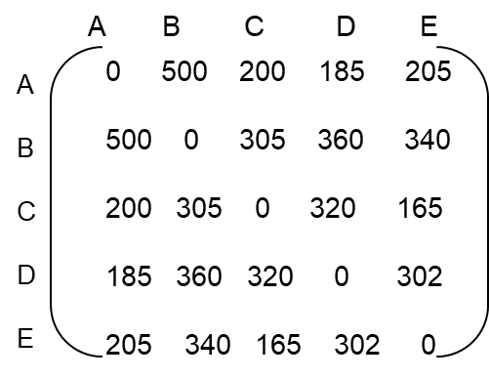
Lets us consider the following weighted graph with vertices A,B,C,D,E and edges are
AB=500, BC=305, CD=320, DE=302, EA=205, AD=185,
DB=360, BE=340, EC=165, CA=200
Adjacency Matrix of given graph:

Slide 11
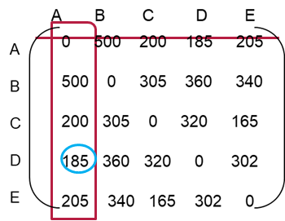
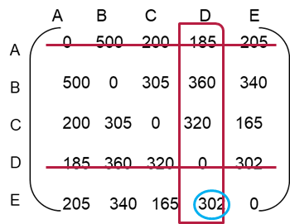
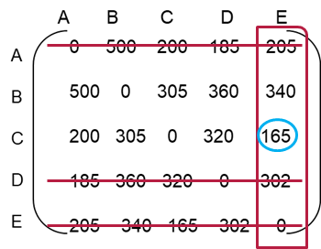
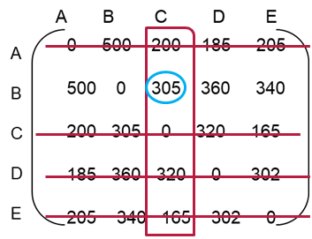
A->D->
A->D->E->
A->D->E->C->
Let consider A as current vertex, now select the nearest neighbour i.e .. D.
Mark the Vertex A as visited and D becomes current vertex. Repeat the same process.
Next nearest one is E, then C and then B.
After all vertex are visited then return to starting vertex.
Our tour: A->D->E->C->B->A
=185+302+165+305+500=1457
A->D->E->C->B

Slide 12
COMPARISON
NEARest neighbour algorithm
CHEAPEST LINK ALGORITHM
This algorithm selects “cheapest edge” and proceed to form hamiliton circuit with restrictions. Once all vertex are visited then it selects edge which returns to starting point.
For the considered weighted graph,
Total distance of shortest possible route=1250
This algorithm selects unvisited vertex and goes to its nearest neighbour unvisited vertex and goes on. Once all vertex are visited it returns to starting vertex.
For the considered weighted graph,
Total distance of shortest possible route =1457

Slide 13
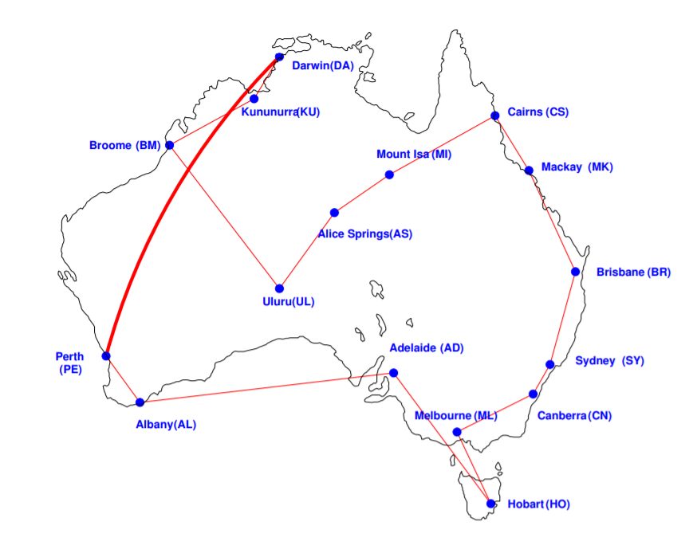
comparison
CHEAPEST LINK ALGORITHM:
Output Edges are:
SY-CN, PE-AL, UL-AS, ML-HO, ML-CN, MK-CS, DA-KU, MK-BR, BR-SY, HO-AD, BM-KU, AS-MI, BM-UL, MI-CS, AD-AL, PE-DA.
Hamilton circuit using CLA: 18,459 km

Slide 14
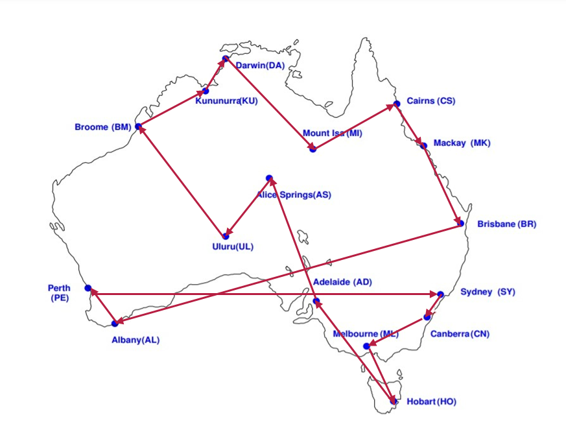
comparison
NEAREST NEIGHBOUR ALGORITHM
Consider Sydney(SY) as Reference Vertex:
SY -> CN -> ML -> HO -> AD -> AS -> UL -> BM -> KU -> DA -> MI -> CS -> MK -> BR -> AL -> PE -> SY.
Hamilton circuit using NNA: 21,049 km.

Slide 15
APPLICATIONS
Finding best route in google maps.
Logistics of delivering goods
Genome sequencing
Drilling holes in circuit boards.
Network design such as determining the amount of cabling required.
In these applications, the concept represents, for example, destination, customers, or dna fragments.
The concept distance represents traveling time, cost, or a similarity measure between dna fragments

Slide 16
CONCLUSION
Clearly, we can say cheapest link algorithm is better than nearest neighbour algorithm.
But sometimes it may be reverse(rarely).
Nearest neighbour algorithm , it misses out some of the shorter routes because of its greedy nature . These shorter routes can be detected by human insight easily.
Both NNA and CLA are efficient but not optimal.
There is no known algorithm to solve the TSP that is both optimal and efficient

Slide 17
REFERENCES
https://www.youtube.com/watch?v=nYKsLRxIBmA
https://www.youtube.com/watch?v=vsoWsr_PVZY
http://www.people.vcu.edu/~gasmerom/MAT131/cheaplink.html
http://www.ijoar.org/journals/IJOARCS/papers/IMPLEMENTATION_OF_HEURISTICS_FOR_SOLVING_TRAVELLING_SALESMAN_PROBLEM_USING_NEAREST_NEIGHBOUR_AND_NEAREST%20_NSERTION_APPROACHES.pdf
https://www.ijser.org/researchpaper/Solving-TSP-using-Genetic-Algorithm-and-Nearest-Neighbour-Algorithm-and-their-Comparison.pdf#:~:text=The%20Nearest%20Neighbour%20Algorithm%20is%20an%20approximate%20algo-rithm,the%20optimal%20one.%20The%20algorithm%20of%20NN%20is%3A
https://jlmartin.ku.edu/courses/math105-F11/Lectures/chapter6-part4.pdf

Slide 18
dynamic programming
The traveling salesman problem (TSP), in which the input is a distance matrix between a set of cities, and the goal is to find a minimum-length tour that visits each city exactly once before returning to the starting point.
In Dynamic programming approach, we use recursive equation to solve the problem. This approach divide the problem into subproblems and then solve it.

Slide 19

DYNAMIC PROGRAMMING:

Slide 20
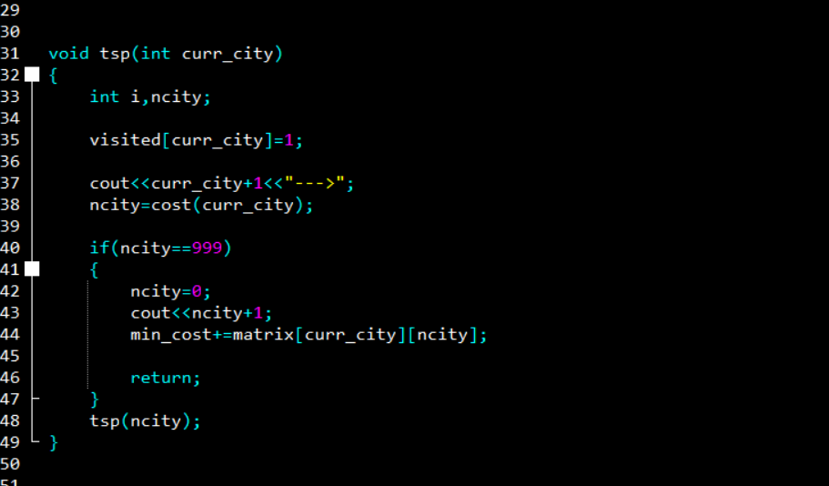

Slide 21
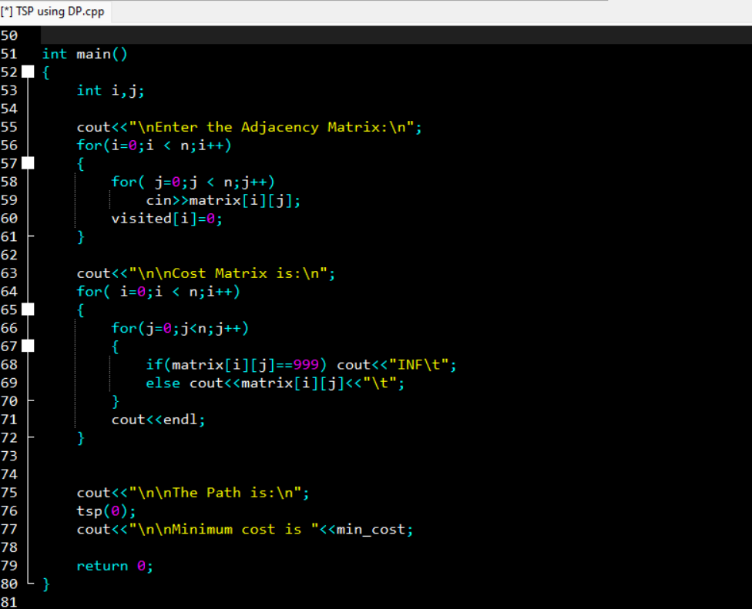

Slide 22
TIME COMPLEXITY:
In the dynamic algorithm for TSP, the number of possible sub-problems can be at most (N-1) *2^{N} i.e. N*2^{N}. Each sub-problem can be solved in O(N) times.
Therefore, the time complexity of this algorithm would be O(N²*2^{N}).

Slide 23
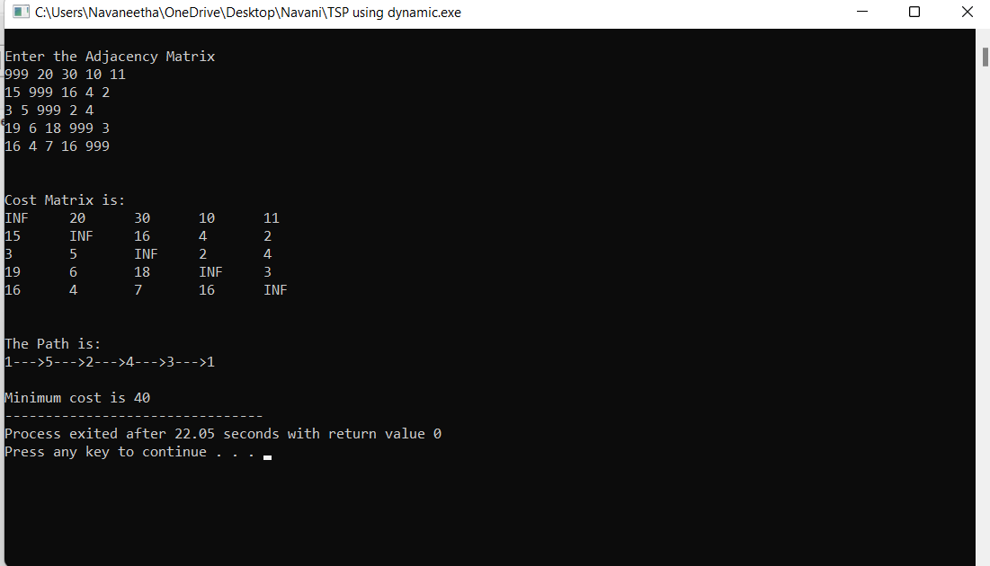
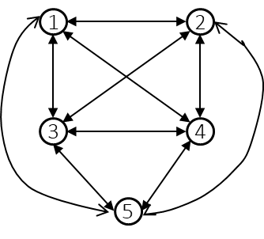
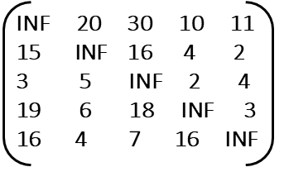
OUTPUT-1:
Minimum Cost path by Dynamic programming is: 1->5->2->4->3->1
Cost is: 40

Slide 24
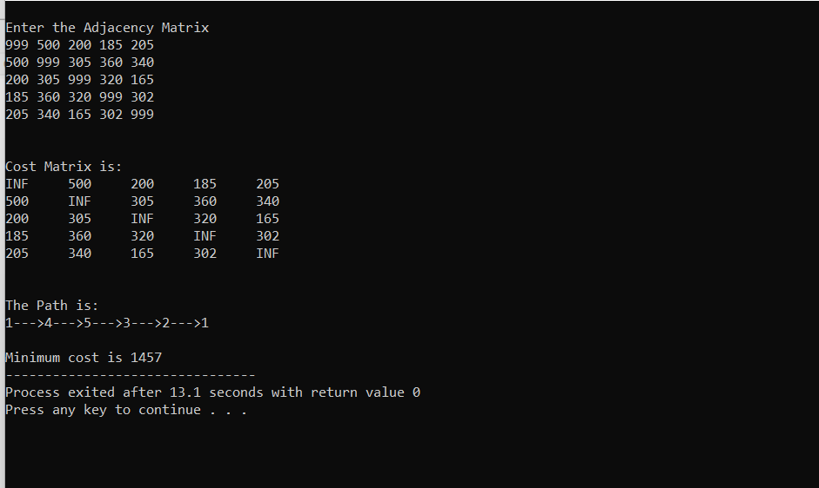
OUTPUT-2:
Minimum Cost path by Dynamic programming is: 1->4->5->3->2->1
Cost is: 1457

Slide 25
branch and bound algorithm
In branch and bound method, we reduce all the rows and columns to get the reduced cost matrix and total cost for root node (i.e. starting vertex ).
At next level, we repeat the same and find reduced cost for all child node( exploring remaining vertex)
Cost of child node = cost of edge b/w parent and child +parent node reduced cost
+ child node reduced cost
Then we branch the child node who have least cost among all and we bound/kill the other child nodes. Repeat the same until all the vertices are traversed.

Slide 26
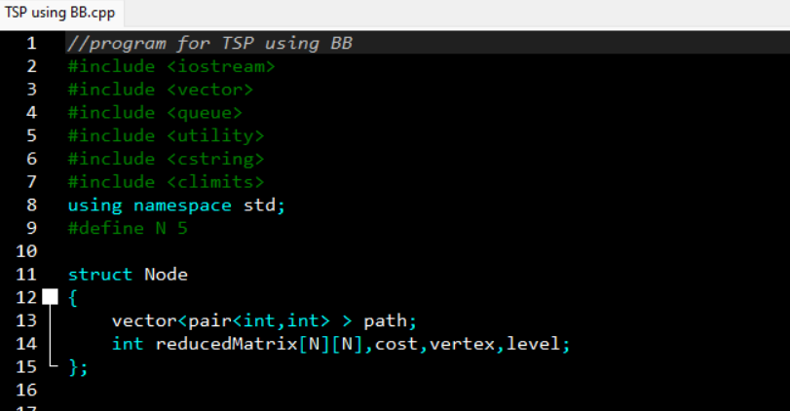
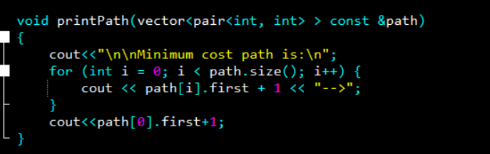
BRANCH AND BOUND:

Slide 27
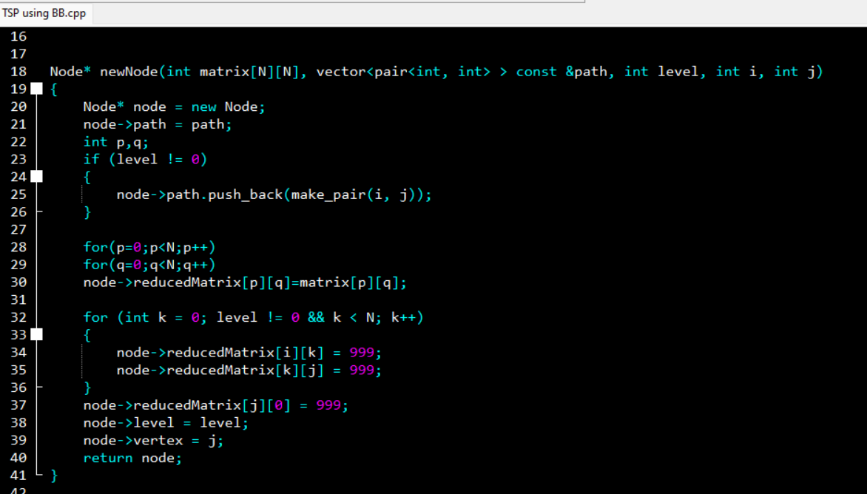

Slide 28
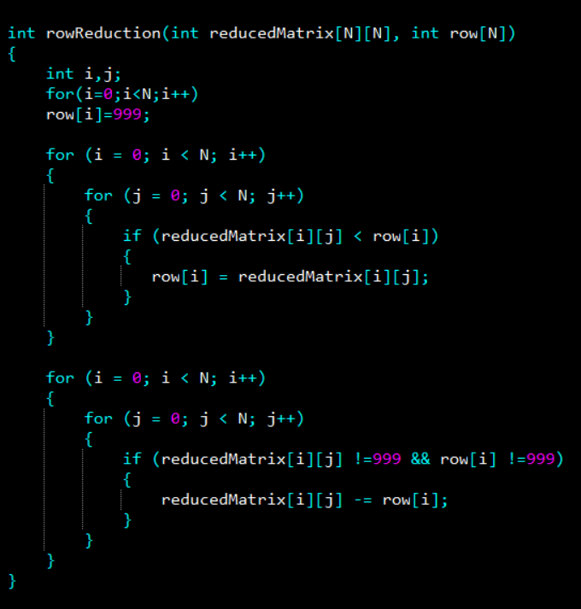
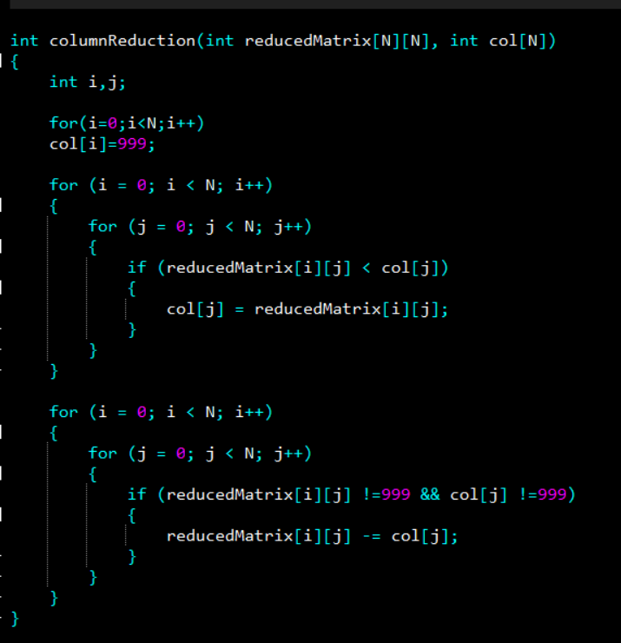

Slide 29
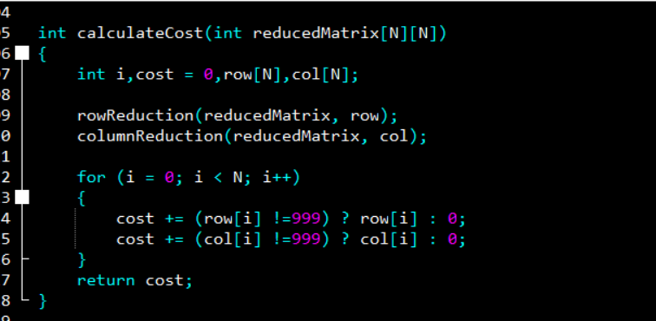
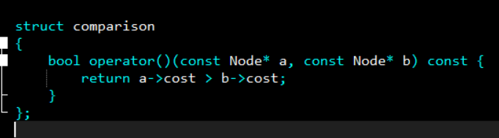

Slide 30
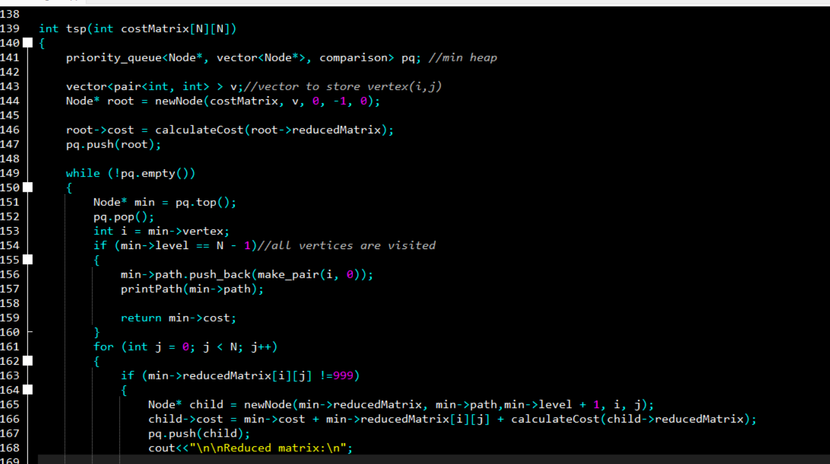

Slide 31
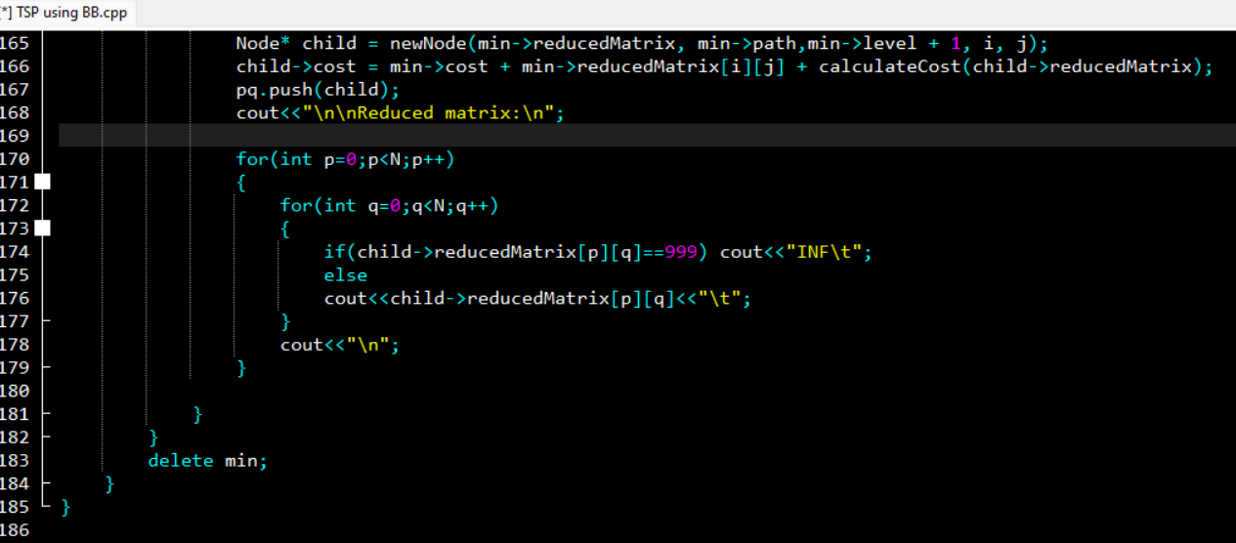

Slide 32
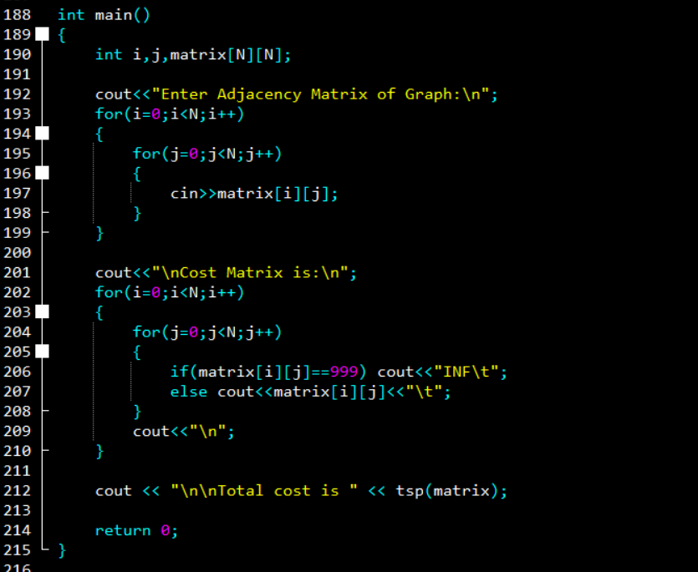

Slide 33
TIME COMPLEXITY:
Time required for row reduction or column reduction is O(N*N)
We need to do this for (N-1) cities i.e. O(2^{N-1})
Final time complexity at worst case is: O(2^{N} * N²)

Slide 34
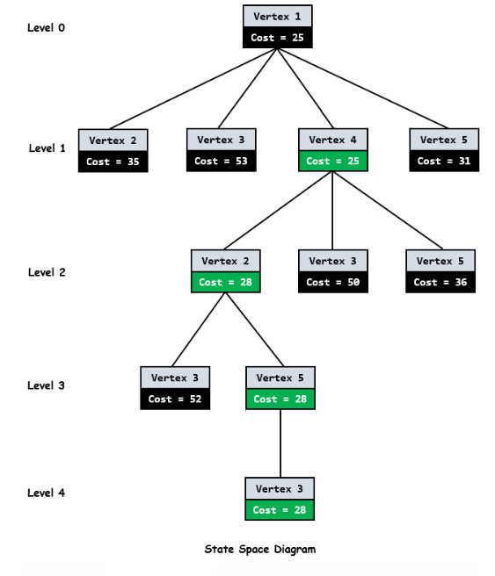
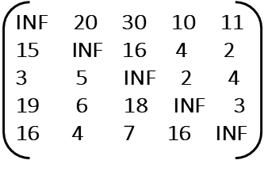
OUTPUT-1:

Slide 35
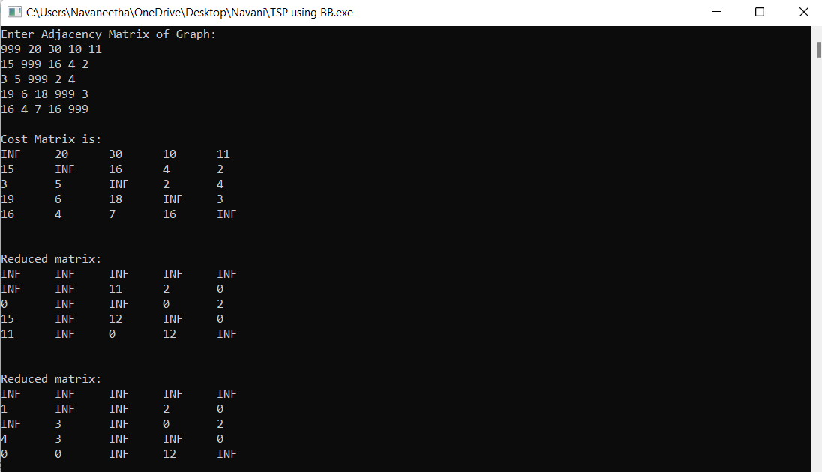
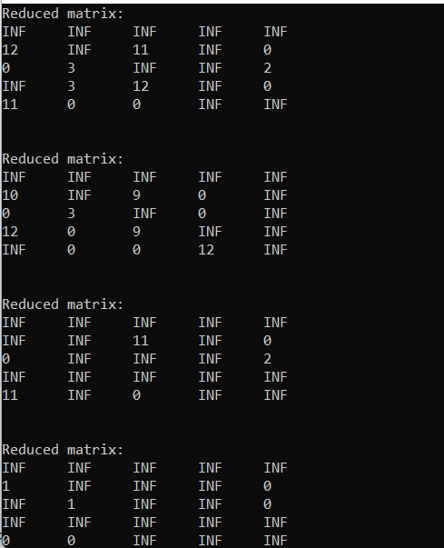

Slide 36
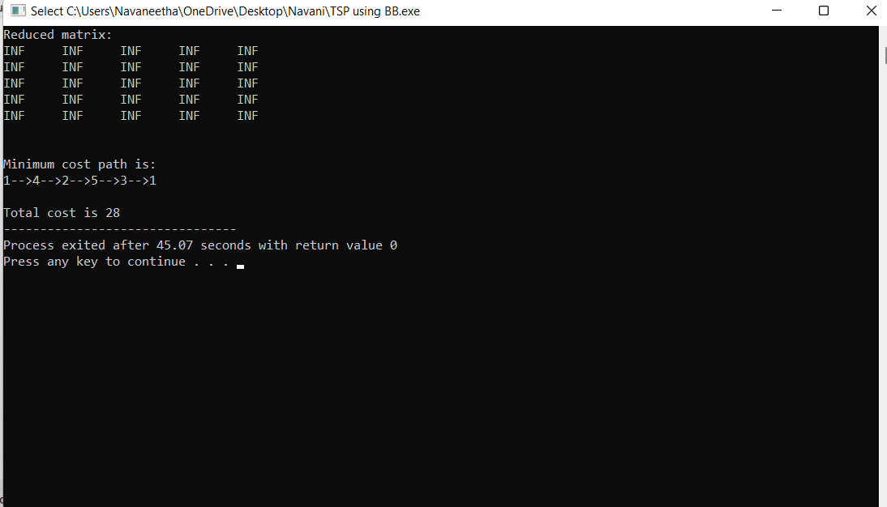
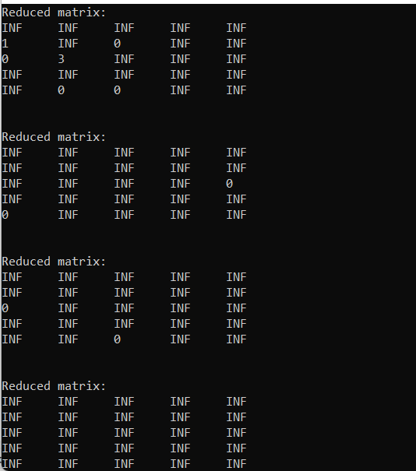
Minimum Cost path by Branch and Bound is:
1->4->2->5->3->1
Cost is: 28

Slide 37
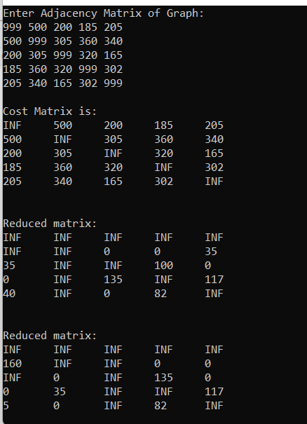
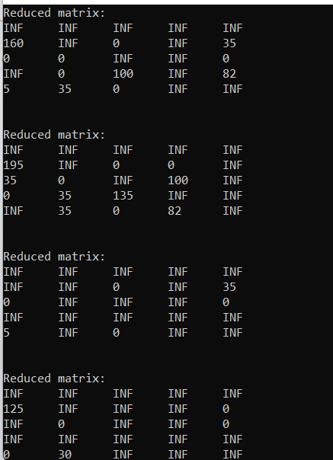
OUTPUT-2:

Slide 38
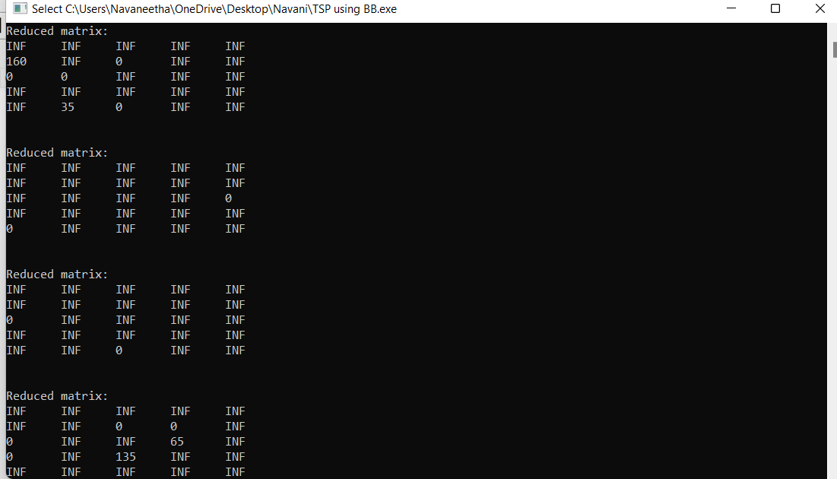

Slide 39
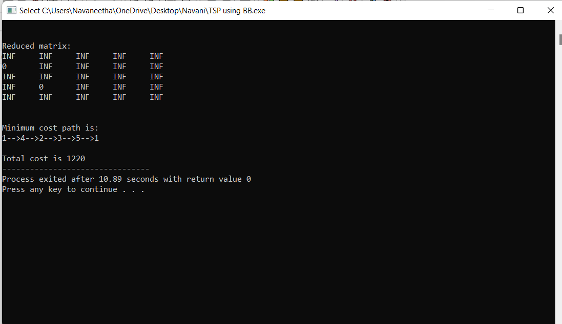
Minimum Cost path by Branch and Bound is: 1->4->2->3->5->1
Cost is: 1220

Slide 40
CONCLUSION
From above examples, We can say that Branch and Bound Approach gives optimal solution than Dynamic programming approach.
One of drawback of Dynamic approach is, it requires more space which is
O(2^{N} * N)
While the worst case complexity of these branch and bound algorithms will not be any better than O(2^{N} * N²), the use of good bounding functions will enable these branch-and-bound algorithms to solve some problem instances in much less time than required by the dynamic programming algorithm.

Slide 41
THANK YOU

